Slide 1

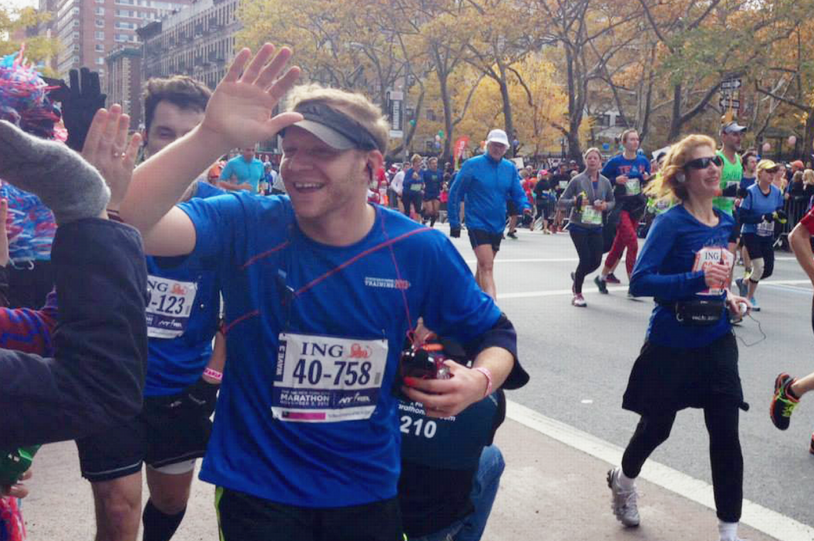
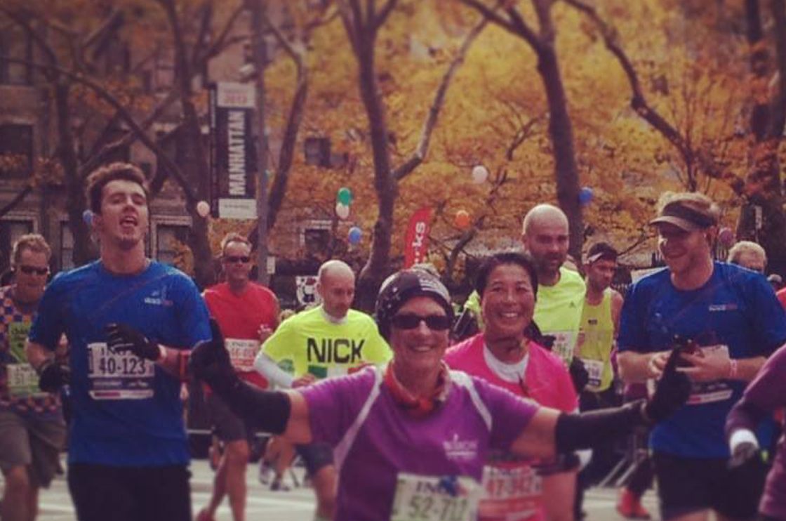
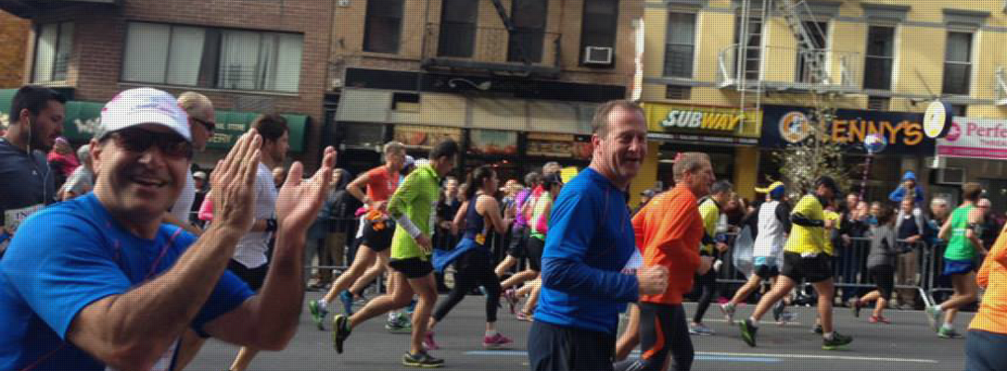

Run. Team AmeriCares.
Join Team AmeriCares to help us save lives and build healthier futures for people in crisis in the United States and around the world – one mile at a time!
Since our founding, AmeriCares has provided more than $12 billion in aid and responded to humanitarian crises large and small. Each year we work with partners in more than 90 countries, putting critically needed medicine and supplies in the hands of health workers and helping them to develop innovative, sustainable health improvements in their communities.
Team AmeriCares supports that mission by raising awareness and funds to support our emergency relief and ongoing global health programs. Each year, members of Team AmeriCares come together to raise hundreds of thousands of dollars – join the team and start making an impact. Together we can raise more funds and help more people in 2015.
Here’s what you get
Guaranteed entry: Spots fill quickly – apply for yours now!
Tips to make your training and fundraising easy and successful
An AmeriCares team T-shirt
Incentive prizes: for top fundraisers
A chance to make a difference: Your fundraising dollars support deliveries of medical and humanitarian aid that can change and save lives.
Access to the Online Training Program from New York Road Runners
Widget Placement on Right hand side of any section?
Apply Now
Application Information
Visit our Team Page
Race with Us
AmeriCares is an Official Charity Partner for races across the United States. Check back as we add races throughout the year.
Here’s our line-up so far in 2015:
March 28, 2015 – Bank of America Shamrock Shuffle 8K – Chicago, IL.
November 1, 2015 – TCS NYC Marathon – New York, NY
Name of Runner
Name of Runner
Join the Team
If you are interested in joining Team AmeriCares this year, please complete this simple application and tell us about yourself and your goals:
Do we Have a Video or clip of
Marathon?
About AmeriCares
Apply Now
WE ARE AN INTERNATIONAL NONPROFIT DISASTER RELIEF AND HUMANITARIAN AID ORGANIZATION.
Since 1982, we have responded immediately to emergency medical needs and supported long-term humanitarian assistance programs for people around the world.
Team Spirit
Team AmeriCares is a growing team of enthusiastic, committed runners who are passionate about endurance sports and AmeriCares lifesaving work worldwide. We set our sights high, support each other and have a lot of fun along the way.
TAKE ACTION. LIKE US. TWEET US. SHARE US. #HASHTAGS
Team members receive team- and race-specific gear and join a community of race enthusiasts who train and run with us to save lives and build healthier futures for people in crisis all over the world!
Our team captain is AmeriCares President and CEO, Michael J. Nyenhuis, an experienced marathoner who exemplifies our team spirit. Between runs, Michael hosts team gatherings and post tips and stories to get our team ready for race day!
More Information
For more information on Team AmeriCares and our endurance event program, please contact Holly Donaldson at hdonaldson@americares.org or at (203) 658-9687.

